Slide 1
Teaching the Humanities: Resources from the Arkansas Humanities Council

Slide 2
Who Are We?
Non-profit 501(c)3 organization
Affiliate of the National Endowment for the Humanities
Governed by a 24 member Board
Empower Arkansans to connect with the humanities by encouraging the discovery and understanding of our diverse and mutual experiences

Slide 3
Our Core Message
Connect and engage Arkansans in the humanities, so that they can discover and appreciate our diverse lived experiences.
Foster and further the humanities through educational initiatives, partnerships, programming and grant-making which include:
Public programs, community forums, education outreach, teaching materials
Technical assistance, grant assistance, personalized support to humanties non-profits

Slide 4
What are the humanities?
"The term 'humanities' includes, but is not limited to, the study and interpretation of the following: language, both modern and classical; linguistics; literature; history; jurisprudence; philosophy; archaeology; comparative religion; ethics; the history, criticism and theory of the arts; those aspects of the social sciences which have humanistic content and employ humanistic methods; and the study and application of the humanities to the human environment with particular attention to reflecting our diverse heritage, traditions, and history and to the relevance of the humanities to the current conditions of national life.”
--National Foundation on the Arts and the Humanities Act, 1965, as amended

Slide 5
Or to put it another way…
“Through the work of humanities scholars, we learn about the values of different cultures, about what goes into making a work of art, about how history is made. The humanities preserve the great accomplishments of the past, help us understand the world we live in, and give us tools to imagine the future.”
---Stanford Humanities Center
“The humanities are the stories, the ideas, and the words that help us make sense of our lives and our world. The humanities introduce us to people we have never met, places we have never visited, and ideas that may have never crossed our minds.”
---Ohio Humanities Council

Slide 6
Why Do Definitions Matter?
There are many different academic definitions of the humanities. Definitions only matter when you are requesting funds.
Grant guidelines set by NEH that, surprise, guide applicants with criteria that must be met. If you want the money, you have to follow the guidelines and definitions.

Slide 7
Types of Funded Programs
Seven Different Grants – each fund a specific type of program or project
Additional Specialty Grants as Funds Allow
YES to public programs, lecture and discussion series, exhibits, publications, podcasts, documentaries, historical markers, historical research and other innovative humanities based projects; including classroom humanities projects.
Not allowed
Social, religious or political action programs that advocate a specific point of view
Projects primarily intended to promote an organization or its programs
Fundraising, international or non-economy domestic travel, meals or entertainment
Creative or performing arts, STEM projects
Grants for personal projects, fellowships or scholarships

Slide 8
AHC Education Grants
Three different grants support teachers in preparing students for life-long humanities engagement and learning, along with providing grants for professional development.
2 types of REACH grants, the Arkansas State Park Field Trip grants, and additional specialty grants, as funding allows
The Arkansas Humanities Council recognizes the important role of educators in helping K-12 students learn to use the humanities to understand their world and to communicate their worldview to others.
Notes:
These grants can be used for PD and classroom projects that power your students imaginations, help them make sense of the world we live in, open their minds to the experiences of others and expand their understanding. Humanities projects can make your students curious about people and places, clarify our roles as citizens in a democratic society and help them to weigh ideas, statements and discourse they hear and read.

Slide 9
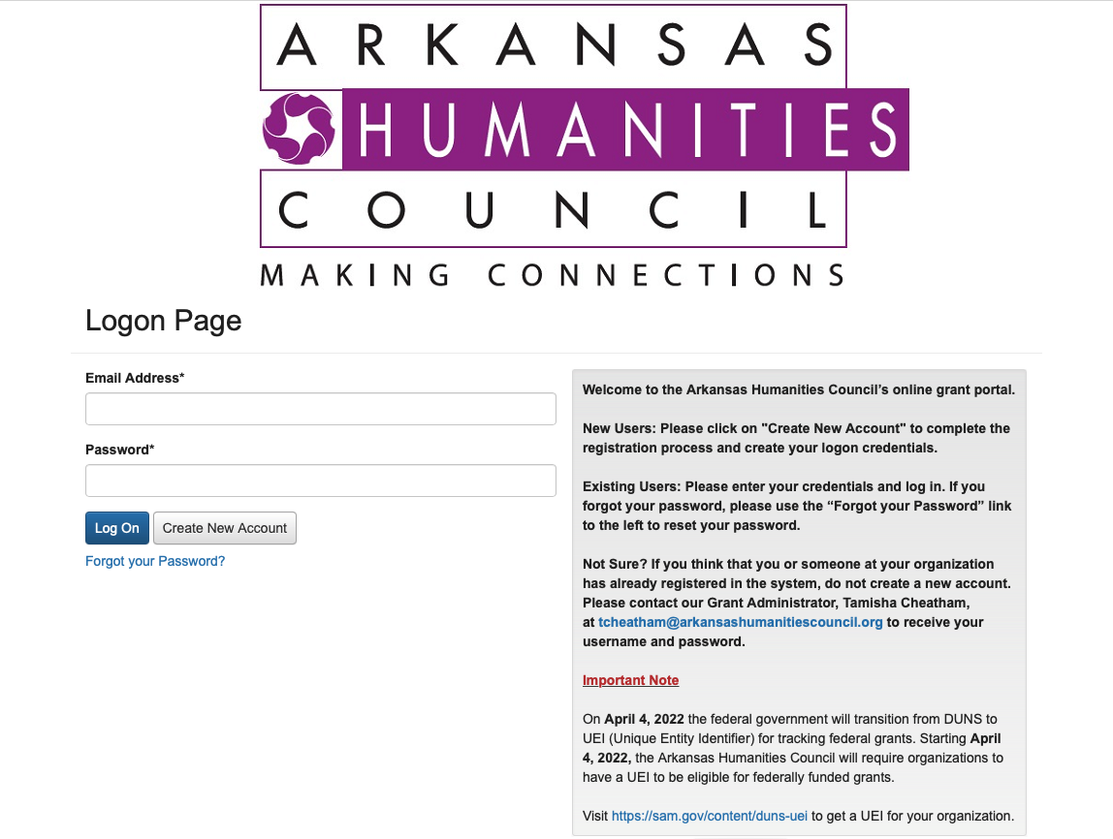
How to Apply for Grants
Visit our website: www.arkansashumanitiescouncil.org
Link to create Foundant account on AHC website
Application and grant management are online on Foundant platform
Fill out and submit your application
What happens after you apply? Review Process
Your grant application is approved! What now?
Reporting – grant agreement, initial funding request, quarterly and final

Slide 10
REACH Grants
Deadlines: First of Each Month Except December
Maximum Award: $ 3,000
PK-12 teachers, librarians and media specialists are eligible
Two types
Humanities-based K-12 grade classroom projects/lesson plans (in-person/virtual)
All lesson plans developed during the project must be shared with the AHC.
Professional Development (in-person/virtual)
Teacher conferences, workshops, webinars, etc. In-state or Out of State
Funds Cover: registration fees, travel costs, teaching materials, books, etc.
Must disseminate PD content learned or presented to colleagues at school, district, or education co-ops
Notes:
Raising Education Achievement and Competence in the Humanities

Slide 11
REACH Grant Professional Development
Professional Development – conference or seminar must have clearly defined humanities content and grant must have strong plan to share and disseminate information gained by attendance.
Grant examples
Foundant Account Registration https://www.grantinterface.com/Home/Logon?urlkey=arhc
Application Process
Fill out and submit application
Application is reviewed by staff and forwarded to REACH grant committee
Allow two weeks for staff and committee review and decision
Next steps if approved by REACH grant committee
Submit Grant Agreement and Initial Payment Request by assigned deadline (50%)
Submit Quarterly Report by assigned deadline (25%)
Submit Final Report by assigned deadline (25%)

Slide 12
REACH Grant Classroom Project
Classroom Projects – Lesson or unit plans, group projects with a STRONG emphasis on humanities content
Grant examples Johnny Cash, We the People, Graphic Novel
Foundant Account Registration https://www.grantinterface.com/Home/Logon?urlkey=arhc
Application Process
Fill out and submit application
Application is reviewed by staff and forwarded to REACH grant committee
Allow two weeks for staff and committee review and decision
Next steps if approved by REACH grant committee
Submit Grant Agreement and Initial Payment Request by assigned deadline (50%)
Submit Quarterly Report by assigned deadline (25%)
Submit Final Report by assigned deadline (25%)

Slide 13
Arkansas State Parks Field Trip Grant
Deadlines: First of Each Month Except December
Maximum Award: $1,000
K-12 grades eligible
52 Arkansas State Parks
Interpretive Programming
Schedule w/ Park Interpreter
Apply for Grant; Allow 7-10 days for review by grant committee and approval
Decisions Made Monthly

Slide 14
Helen T. Leigh Museum Field Trip Grant
Deadlines: First of Each Month Except December
Maximum Award: $ 500
Grades 3 – 12
MacArthur Museum of Arkansas Military History
Field Trip
Interpretive Programming
Decisions made monthly

Slide 15
Other Grants
Major Grant – Once a Year
Deadline: September 15th
Award: $3,500 to $15,000
For research, publications, public programs, film preproduction and production, and other media (exhibits, websites, podcasts)
Minigrant – Twice a Year
Deadline: January 15 and June 15
Maximum Award: $3,000
For public programs, research, publications, preproduction and other media

Slide 16
Other Grants
African American History and Culture – Four Times a Year
Deadlines: February 15, May 15, August 15, November 15
Maximum Award: $5,000
For research, documentation, preservation, and interpretation of Arkansas’s African American history and culture
Access to the Humanities
Deadlines: First of each month except December
Maximum Award: $1,500
To provide captioning services, ASL interpreters for in-person or online events, acquiring services to make documents, website, and/or exhibits accessible, and video captioning

Slide 17
AHC Education Programs
The Arkansas Humanities Council recognizes the important role of educators in helping K-12 students learn to use the humanities to understand their world and to communicate their worldview to others.
New programming, professional development and curriculum development for teachers, by teachers
All education programs, classroom resources, and grant applications links in one place on our website – Teachers Page.
Teachers page content includes free resources for teachers, students, and parents searching for K-12 materials in the subject areas of history, social studies, literature, language arts, culture and heritage.

Slide 18
Initiatives Include
2022 Professional Development Workshops
New voting rights professional development series based on this model for the 2022-2023 school year
Voices and Votes Traveling Smithsonian exhibit Spring 2023- January 2024
Field trip grants for classrooms to visit Voices and Votes host sites
Hugh’s Kids Club – PK-2nd grade program that introduces young learners to humanities topic through fun activities.
Notes:
You are dedicated, connected, knowledgable, hardworking professionals. We are too – we want you to partner with us. We provide the funding, technical support and programming that give you access to resources, experts, education and information.

Slide 19
2022 Summer Professional Development Schedule
Classroom Grants, Civic Literacy and More: Free Resources from the Arkansas Humanities Council and the Clinton Presidential Library
June 9 Crowley’s Ridge Co-Op Walnut Ridge 6
June 10 Arch Ford Co-Op Plumerville 6
June 20 AR River Co-Op Pine Bluff 3
June 21 Wilbur Mills Co-Op Beebe 6
June 23 Southcentral AR Co-Op Camden 6
July 12 Shiloh Museum Springdale 3
July 13 North Central Co-op Melbourne 6
July 20 DeQueen-Mena Co-op Gillham 6
July 21 REAL Conference Little Rock 3
July 22 ASI Roberts Library Little Rock 6
July 25 Dawson Co-Op Arkadelphia 6
July 27 Southeast AR Co-Op Monticello 6
Aug 2 Southwest AR Co-Op Hope 6

Slide 20
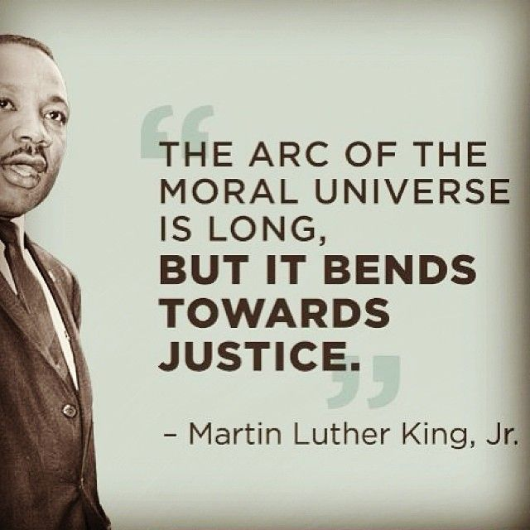
Bending Toward Justice Seminar Series
Middle School and High School voting rights history programs Fall of 2022
PK – 5th programs Spring of 2023
Leading up to November 2022 election and opening of Voices and Votes exhibit at the State Capitol in Spring of 2023
2-3 programs in each series, professional development credit awarded
Programs open to the public

Slide 21
Voices and Votes: Democracy in America Traveling Exhibit Summary
“You are there” adventure of U.S. political history through displays of artifacts, drawings, photos, videos, multimedia quizzes, presentations and interactive kiosks. The story unfolds from the early days of the American colonies to today, from the Boston Tea Party to the civil rights era and various marches on Washington.
A Great Leap of Faith explores questions that the nation’s commitment to popular sovereignty raised: Who were the people? And, who should those people make their voices heard by the government?
One Voice, One Vote: In a nation by the people, for the people, who should have a voice in the political process?
The Machinery of Democracy explores the history of campaigning and voting; and how politicians invented a uniquely American system of electing representatives.
Beyond the Ballot examines how citizens and interest groups influence through protests, petitions and lobbying.
Creating Citizens examines how America brings together people of different backgrounds, interests, occupations, social ranks, religious beliefs and regions.
Concepts to Consider sections end each topic with guiding questions for the viewer to answer.

Slide 22
Voices and Votes: Democracy in America Traveling Exhibit Education Resources
Created by Smithsonian Lesson plans, adult and youth reading lists, teachers guide, exhibit handbook
Available as PDFs from MoMS website: https://museumonmainstreet.org/content/resources?field_resource_exhibition_tid=256
Finding Aid Portal https://www.salisbury.edu/libraries/nabb/_files/FindingAidPortal/Voices-and-Votes-Lesson-Plans-and-Educational-Resources.pdf
Companion lesson plans available on AHC website and Clinton Library website, along with many of the digital humanities resources to be presented

Slide 23
Voices and Votes: Democracy in America Traveling Exhibit Schedule
April 15, 2023 – January 28, 2024
April 15 – May 26, 2023 Arkansas State Capitol Little Rock
June 1 – July 14 Delta Gateway Museum Blytheville
July 21 – September 1 Old Independence Regional Museum Batesville
Sept 8 – Oct 20 John Brown University Siloam Springs
Oct 27 – Dec 8 Arts and Science Center of Southeast Arkansas Pine Bluff
Dec 15, 2023 – Jan 28, 2024 Southern Arkansas University Magnolia

Slide 24
Hugh’s Kids Club
Humanities focused activities provided by the Arkansas Humanities Council
Can be used in the home, day camps, libraries and humanities organizations. Adaptable for PK-2 classroom activities
Free classroom sets available to order
Correlates with Arkansas Frameworks
Teachers register for classroom sets; parents register for home activities

Slide 25
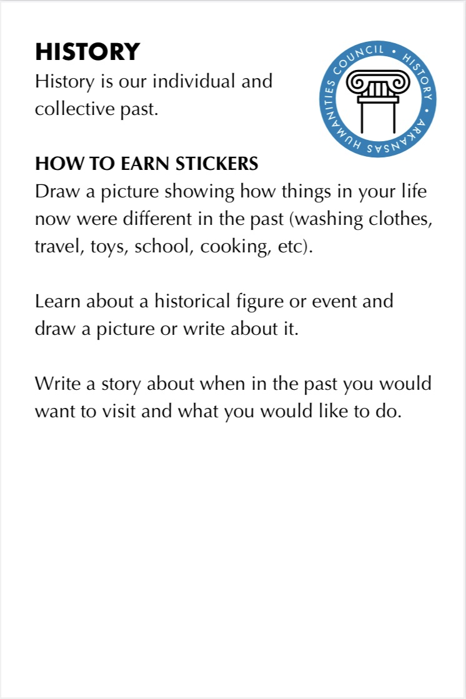
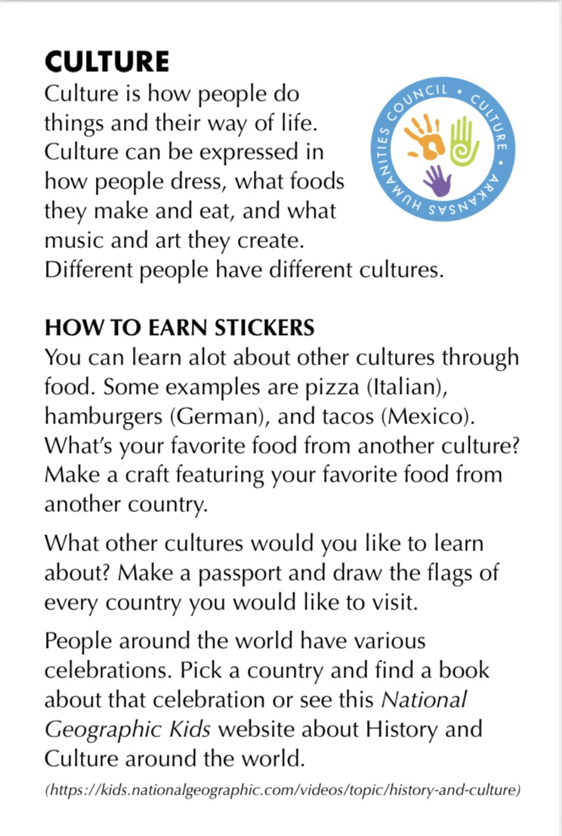
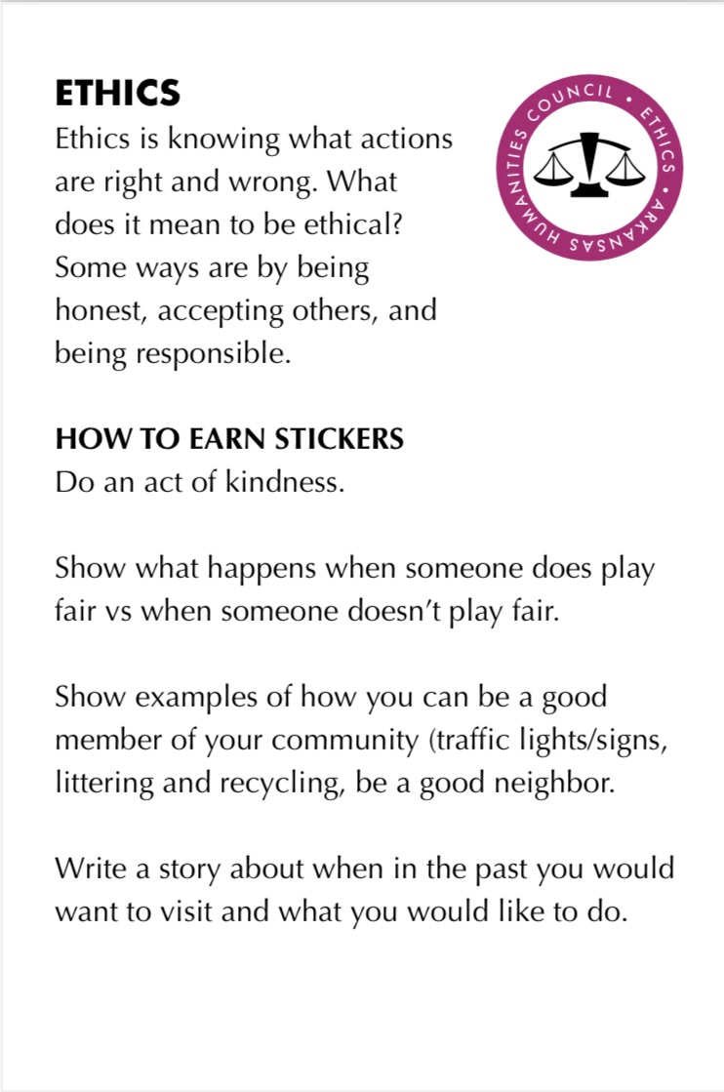
Hugh’s Club Flashcard Topics & Stickers
9 Humanities Area Activities
History
Culture
Archeology
Ethics
Literature
Language
Holidays
Art History
Music History

Slide 26
Hugh’s Kids Club Classroom Packet
Flashcards with humanities focused activities
Hugh poster
Classroom set of Humanities stickers
Classroom set of Hugh coloring books
Standards Correlation Guide
Other fun items are coming
Classroom Decorations
Classroom Prizes
Register here: https://docs.google.com/forms/d/e/1FAIpQLScK_CjvDiyQMReFX0ZJp024islXKujb_uGgbFW6TmGrn7QzjQ/viewform?usp=sf_link

Slide 27
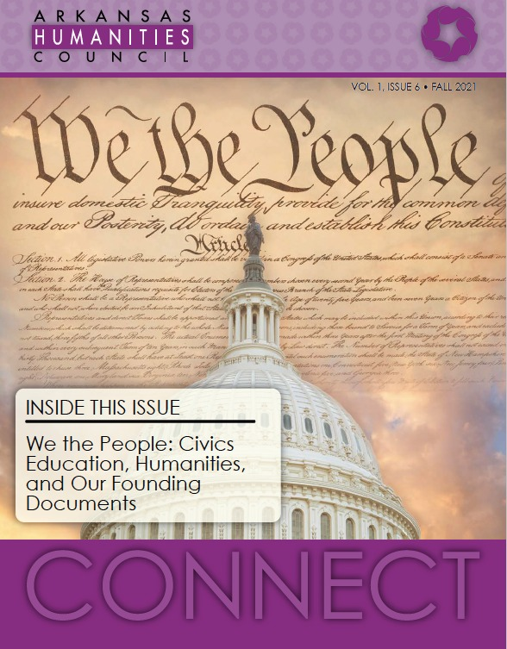
Digital Humanities Education Resources
AHC website: www.arkansashumanitiescouncil.org
Programs Tab – Teachers Page
Connect Magazine – Teacher’s Lounge, Hugh Manatee
Highlights grants/projects, partnerships
Published twice a year, copy mailed to home or digital version to your inbox. Available in English and Spanish
AHC Social Media – Facebook, Instagram, Twitter
Workshop Wednesday, additional grant opportunities and programs

Slide 28
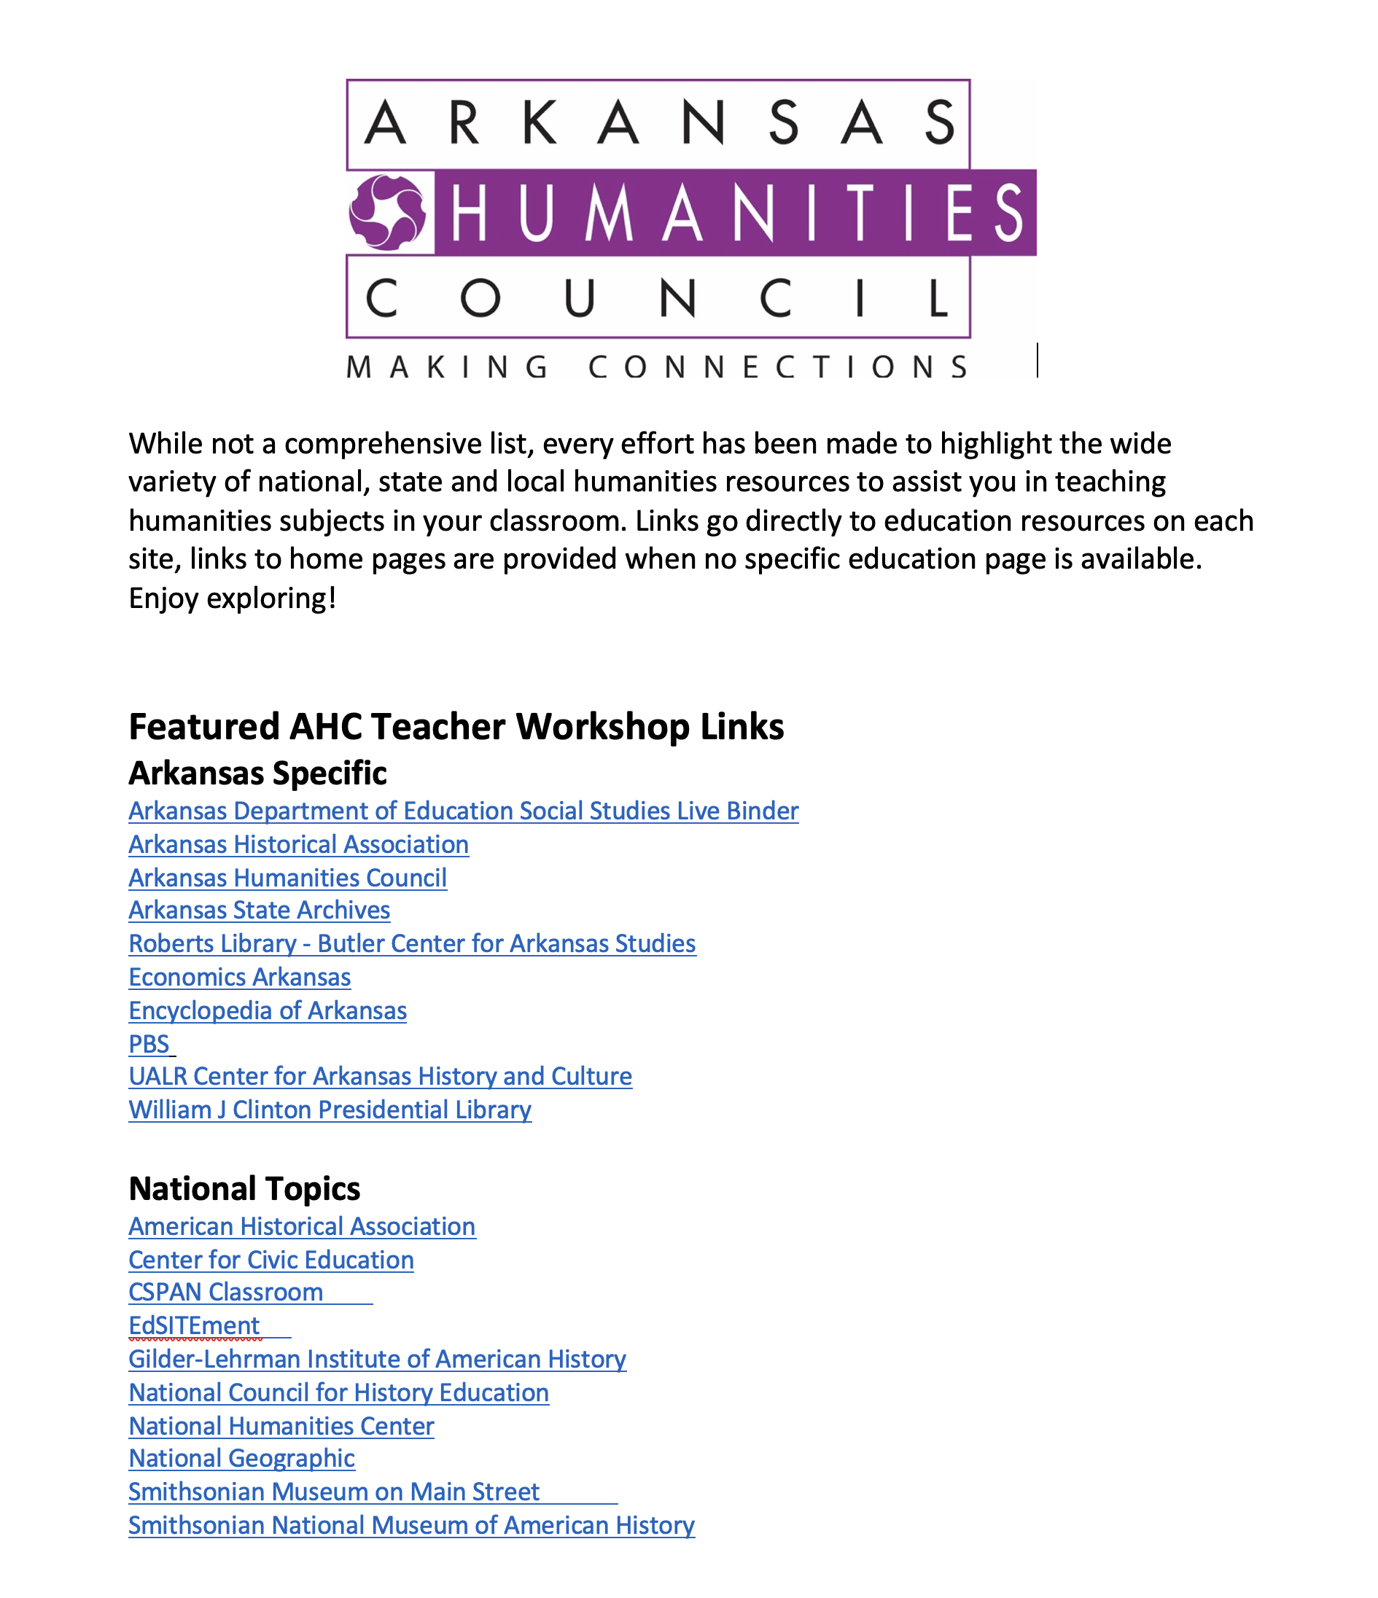
Digital Humanities Resources
Flash drives – AHC and CPL presentations and…
Humanities Digital Resources Workshop List

Slide 29
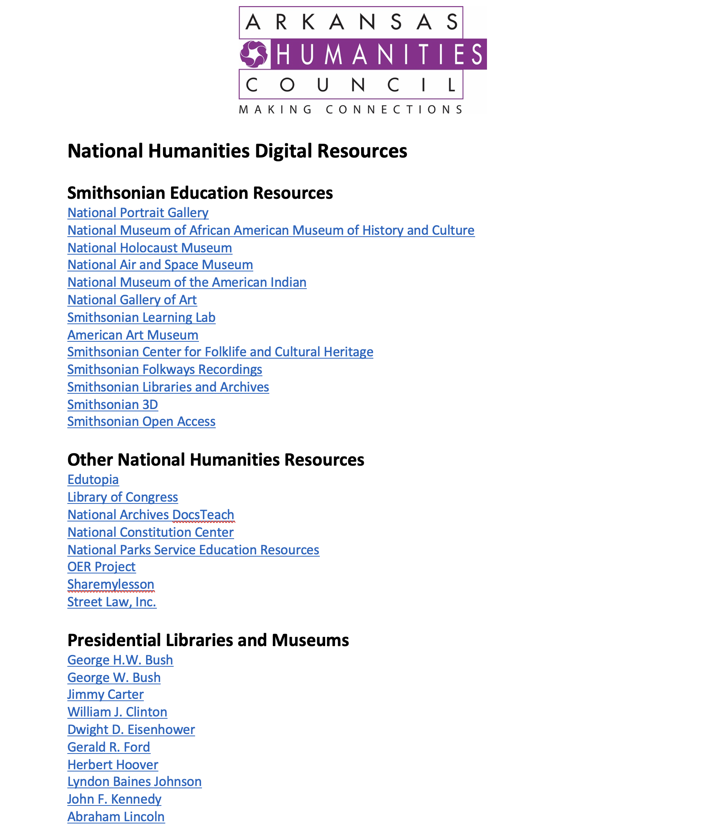
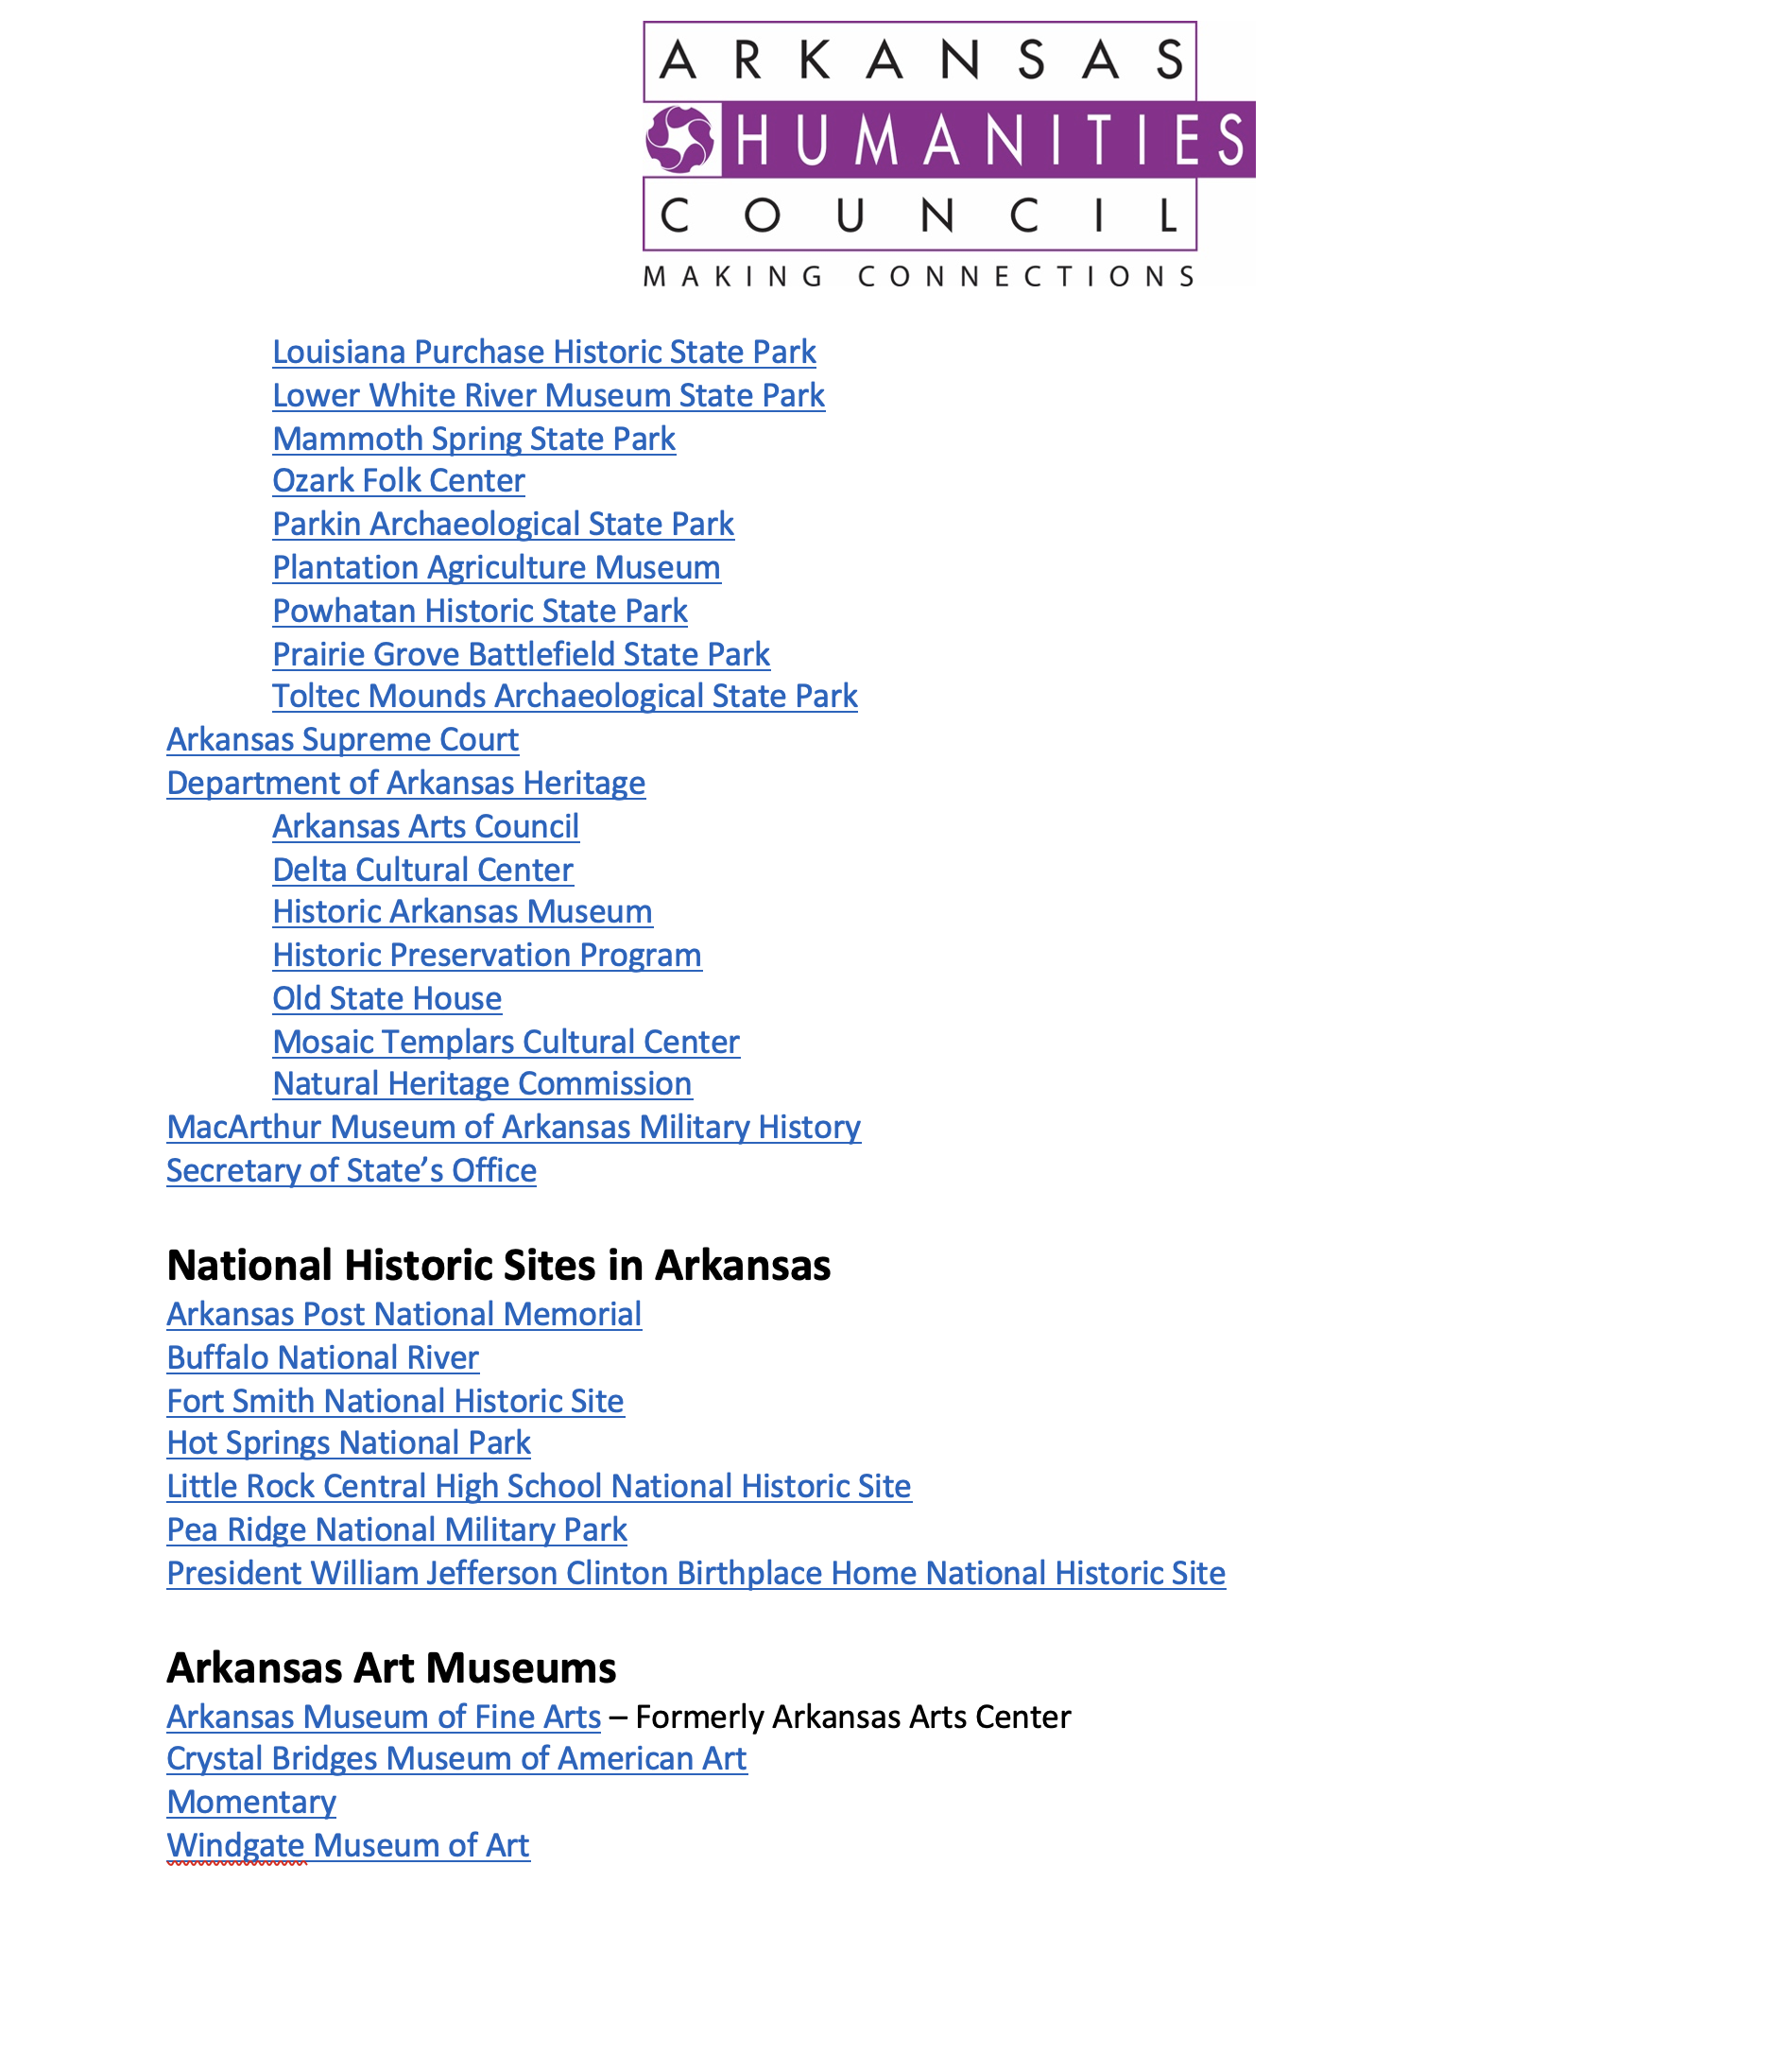
Digital Humanities Resources

Slide 30
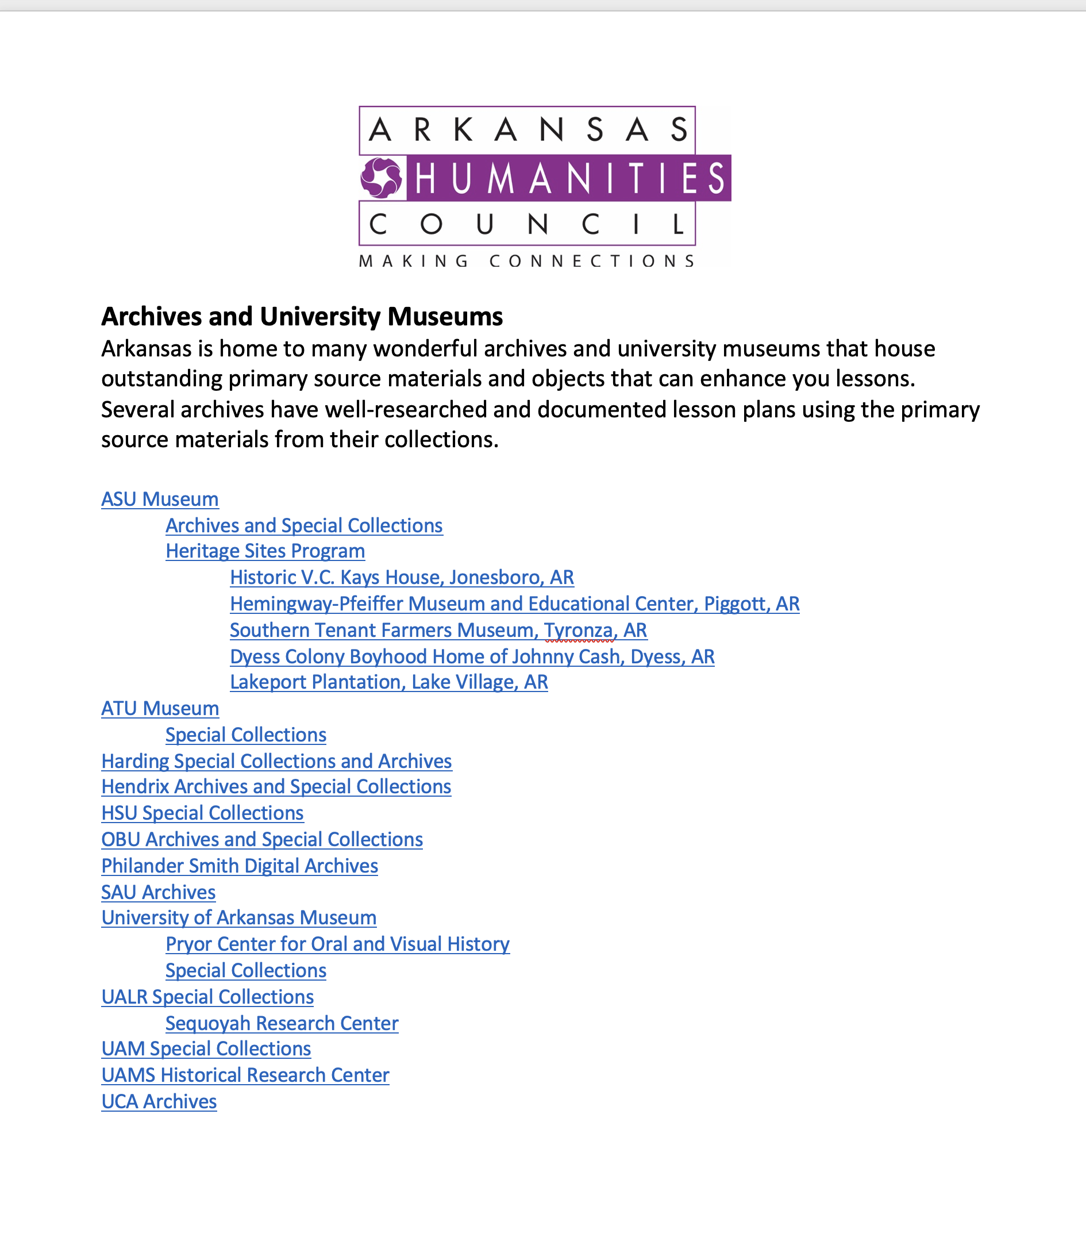
Digital Humanities Resources

Slide 31
Digital Humanities Resources
Highlights of a few included resources:
EdSITEment
Center for Civic Education
Roberts Library – CALS
UA Little Rock Center for Arkansas History and Culture
Arkansas Department of Education Civics Live Binder

Slide 32
Digital Humanities Resources
Arkansas State Archives Museum on Main Street
PBS National Geographic
Economics Arkansas National Humanities Center
C-SPAN Classroom National Council for History Education
American Historical Association Smithsonian History Explorer
Gilder-Lehrman Institute of American History

Slide 33
Contact Us
Ann Clements, Education Outreach Coordinator:
aclements@arkansashumanitiescouncil.org
Tamisha Cheatham, Coordinator for Community Engagement tcheatham@arkansashumanitiescouncil.org
Katie Dailey, Chief Financial Officer: kdailey@arkansashumanitiescouncil.org
Monika Hemenway, Director, Development and Communications
mhemenway@arkansashumanitiescouncil.org
Adrienne Jones, Coordinator for Community Engagement -Special Initiatives
ajones@arkansashumanitiescouncil.org
Jamie Middleton, Program Officer for Grants and Public Programs
jmiddleton@arkansashumanitiescouncil.org
Arkansas Humanities Council
1400 West Markham Street, Suite 400
Little Rock, AR 72201
Phone: 501.353.0349
info@arkansashumanitiescouncil.org
Jama Best, Executive Director: jbest@arkansashumanitiescouncil.org

Slide 34
“The arts and humanities define who we are as a people. That is their power -- to remind us of what we each have to offer, and what we all have in common. To help us understand our history and imagine our future. To give us hope in the moments of struggle and to bring us together when nothing else will.” Michelle Obama

